Slide 1

Marketing in a Digital Era
Lecture 6
Dr. Anshu Suri

Slide 2
Exercises on BrightSpace
Remember: Exam has no MCQ
Three Questions Out of Five

Slide 3
How the “Digital” World is Changing the 4P’s of Marketing

Slide 4
Product: Sharing Economy & Non-ownership of Assets
Sharing Economy: A market formed through an intermediating technology platform that facilitates exchange activities among a network of equivalently positioned economic actors
Also called as “Access-based consumption”

Slide 5


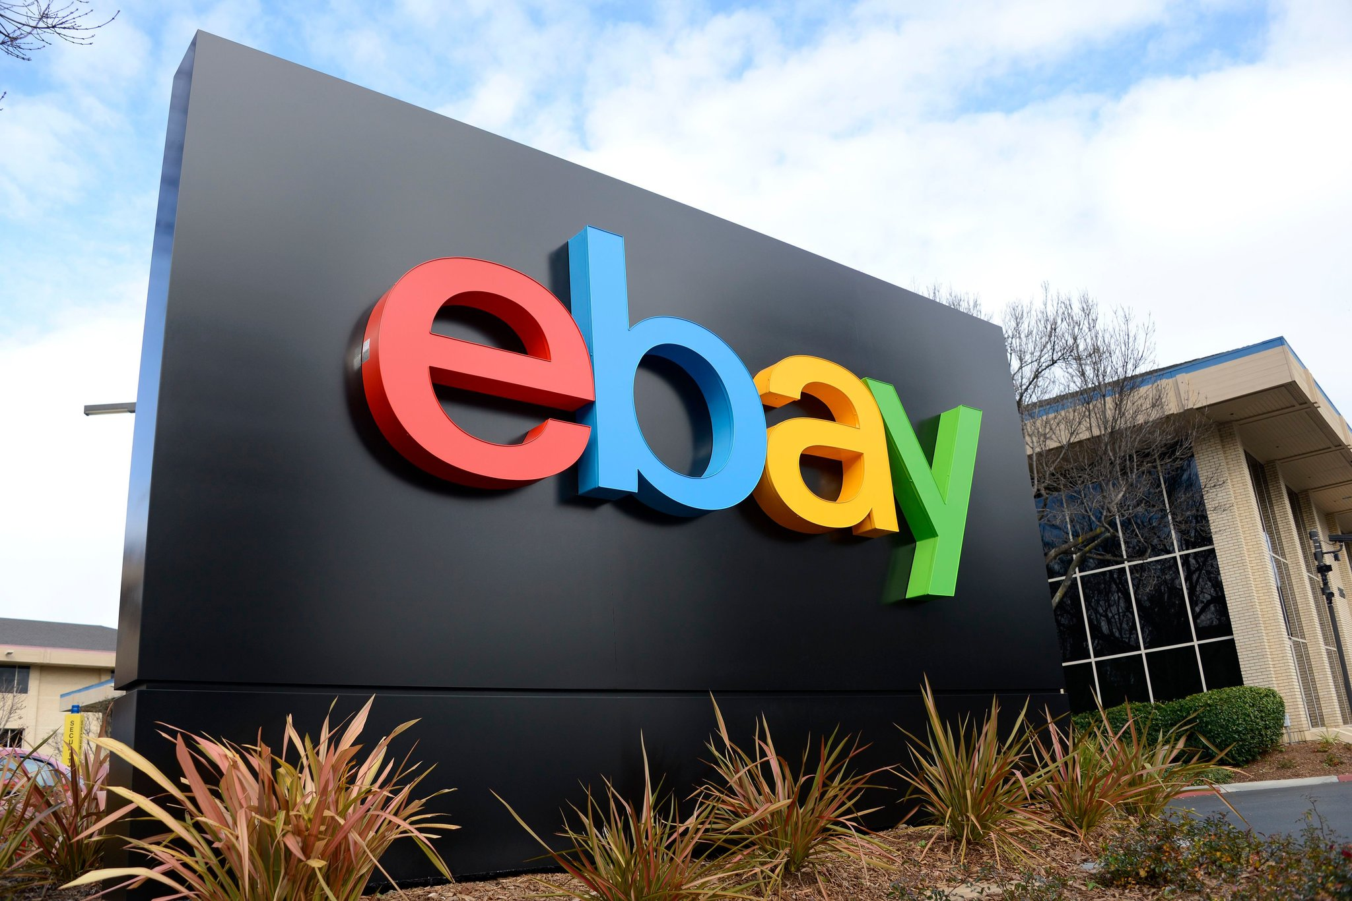


Sharing Economy

Slide 6
Examples of Shift in “Distribution”

Slide 7
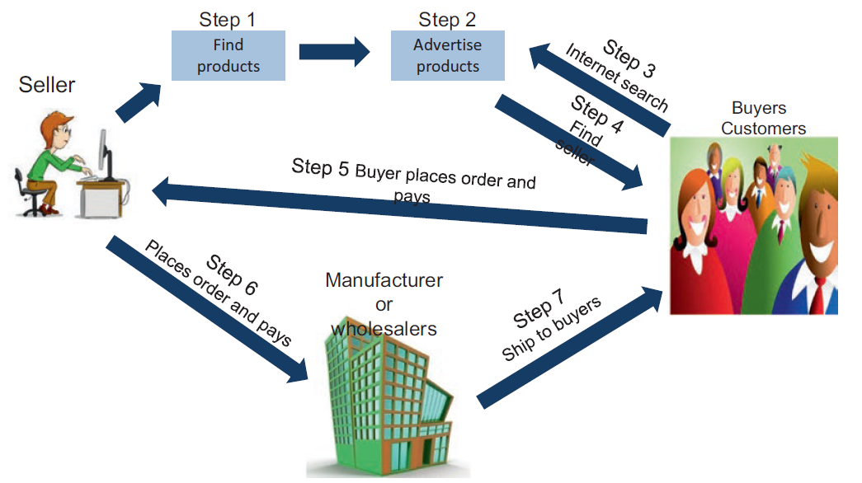
Dropshipping
Form of e-commerce where a business sells products that they do not stock or ship
Source: Turban et al. 2018

Slide 8
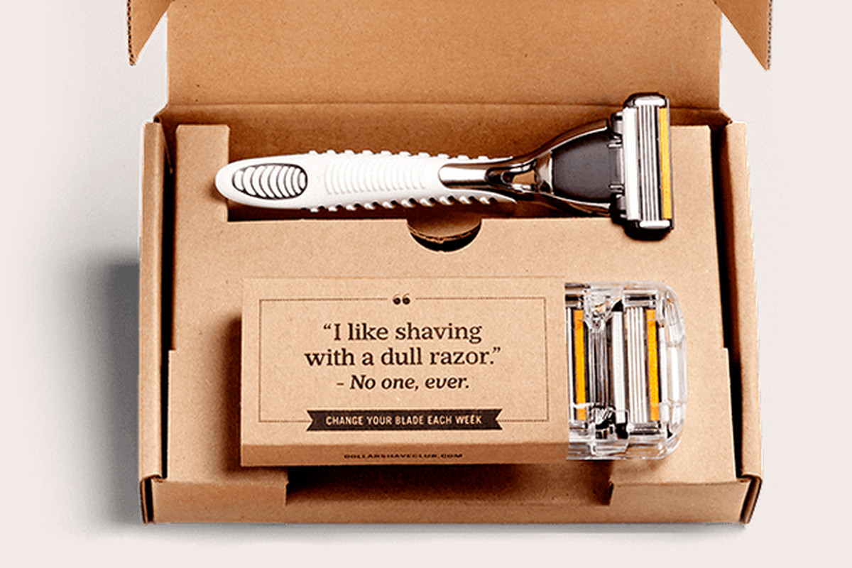

Subscriptions of Physical/Digital Products
Company offers content or services & charges a subscription fee for access to some or all of its offerings
Subscription based revenue model

Slide 9
Examples of Shift in “Pricing”

Slide 10
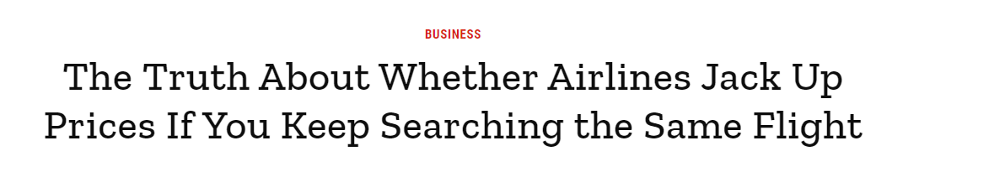
More Opportunities for Dynamic Pricing
Dynamic pricing: adjusting prices continually to meet the characteristics and needs of individual customers and situations

Slide 11
Exercise 1 on Brightspace

Slide 12
Review Session

Slide 13
Process of Marketing Strategy
Segmentation
Targeting
Positioning

Slide 14





Find a Target Segment Before You Introduce a Product
Before you design/introduce a product: Identify a Target Segment that Needs your product
Design/Introduce a Product that fulfills the needs of this target segment
Profitable Company & Happy Consumer

Slide 15


Reverse?
Introduce a Product without identifying a target segment/market research
Find a target

Slide 16


Needs of different Target segments for this Umbrella
Professional
Higher disposable income: Less price sensitive
Values Quality
Acute Need
Student
Less disposable income: Most price sensitive
Does not value Quality
Moderate Need
Retired
Moderate disposable income: Price sensitive
Values Quality
Low Need

Slide 17
But What about profitability?
Only 100 potential consumers like him
1,000 potential consumers like him
200 potential consumers like him

Slide 18
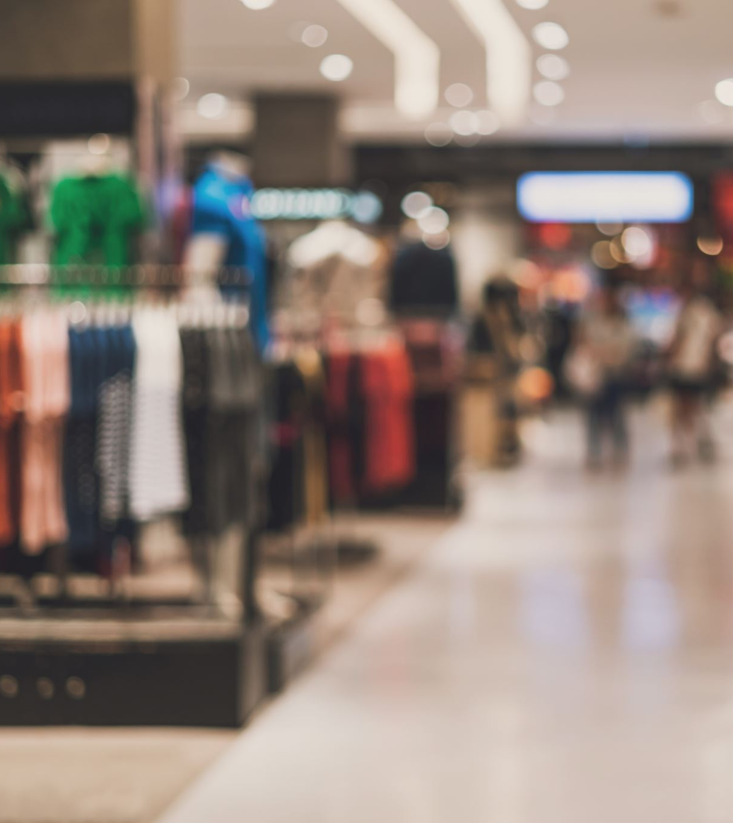
A Segmentation Variable Overlooked: Behavior
Very important in Practice
Usage rate (heavy/light users)
Customer Loyalty : Do consumers keep buying the same brand wrt the category?
  Think Apple : Very high brand loyalty
  Think sugar/milk : Very low brand loyalty
Product knowledge (beginner/experienced)

Slide 19

Revision : Brief Recap of all classes

Slide 20
Marketing’s Contribution to Business
Marketing Contributes to company's:
  Growth
  Sales
  Profitability
  Objectives
Must be aligned with company’s mission and objectives
Marketing planning is a part of business strategy
Company mission and objectives
Business strategies
Financial objective & strategies
Marketing objectives & strategies
Other objectives & strategies
Product and service objectives & strategies
Pricing objectives & strategies
Distribution objectives & strategies
Communication objectives & strategies

Slide 21
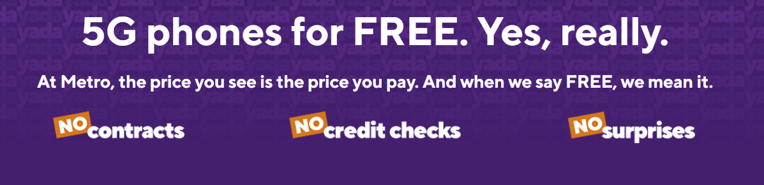
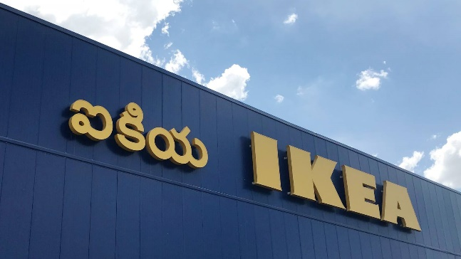
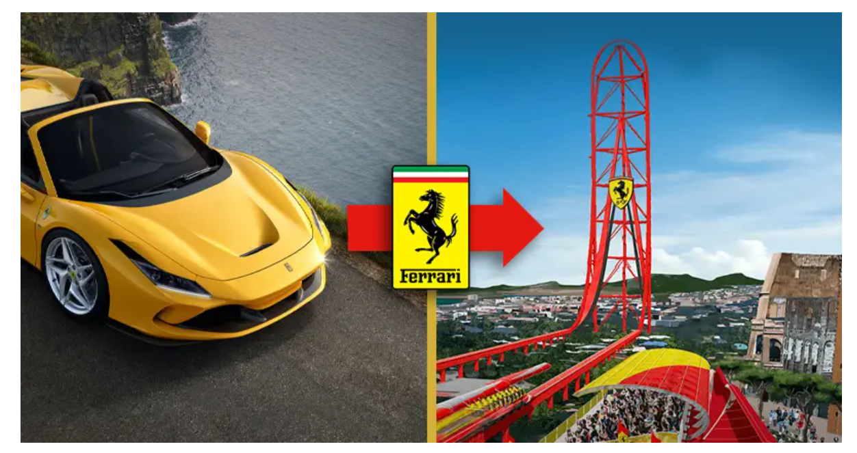
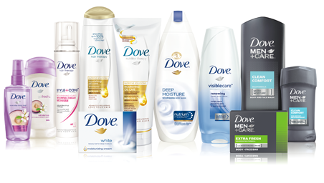
Development Strategies
 | Existing Market | New Market
Existing Product | Market Penetration E.g., increase customer’s rate of usage, attract competitors’ consumers, attract non-users | Market Development E.g., New geographic markets, attract other market segments
New Product | Product Development E.g., Modifications, adaptations, brand extension | Diversification New product for new market

Slide 22
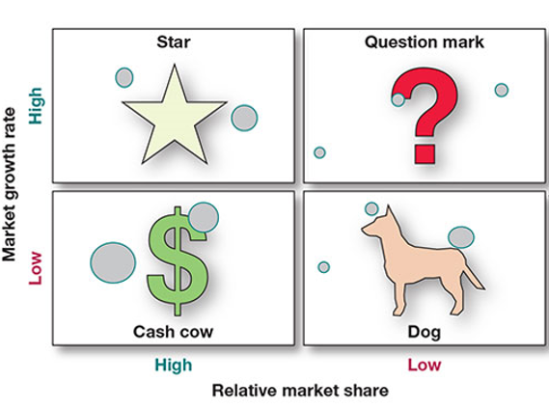
BCG Matrix
Milk the cash cows! : Generally, cash for the firm with minimal/no investment
Stars: Need investment to fund their growth
Question marks/problem child: Need to choose which question marks should be funded. Can turn into a star or a dog.
Kill the dogs: Don’t invest any money

Slide 23








Marketing Planning Process
Analysis
Situation analysis
Setting objectives Resource allocation
Defining the marketing strategy Deciding on the marketing mix Implementation
Strategic decisions
Action programs
16
Control

Slide 24
An organisation vs. its environment
At a Macro level
Product-legal
At a Micro level
Economic
Suppliers
At an organisational level
Social
Distributors
End users
Environmental
Competitors (actual and potential)
Resources
Competencies
Performance
Technological
Substitute Products

Slide 25
Situation analysis: Goals
Macroenvironment
analysis
Microenvironment analysis
Identify strengths & weaknesses
Internal analysis
Identify opportunities & threats
Identify opportunities & threats

Slide 26
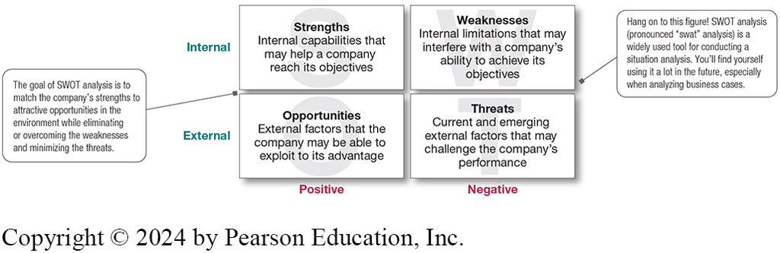
SWOT Analysis

Slide 27
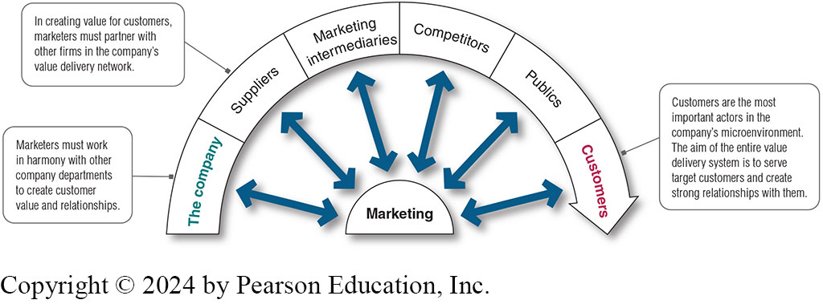
Microenvironment
Notes:
Marketing intermediaries
help the company promote, sell, and distribute its products to
final buyers. They include resellers, physical distribution firms, marketing services agen
cies,
and financial intermediaries. Resellers are distribution channel firms that help the com
pany
find customers or make sales to them. Coca-Cola assigns cross-functional teams dedicated to understanding the
finer points of each retail partner’s business

Slide 28
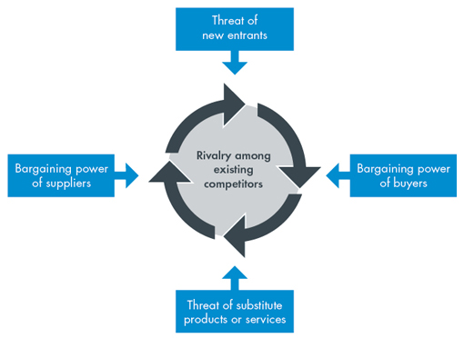
Microenvironment Analysis: Porter’s Five Forces model
Tool to identify the main challenges (threats) or the best opportunities that may arise in the market

Slide 29
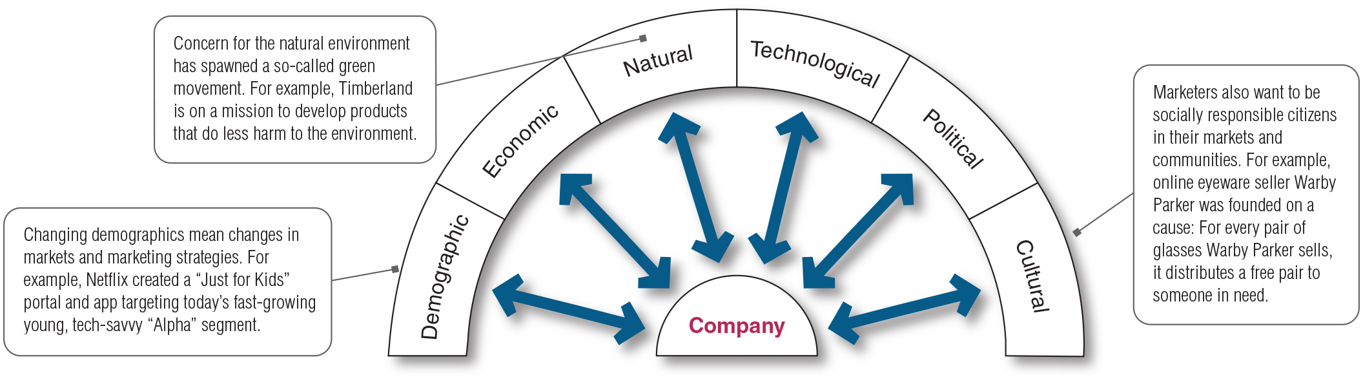
Macroenvironment

Slide 30
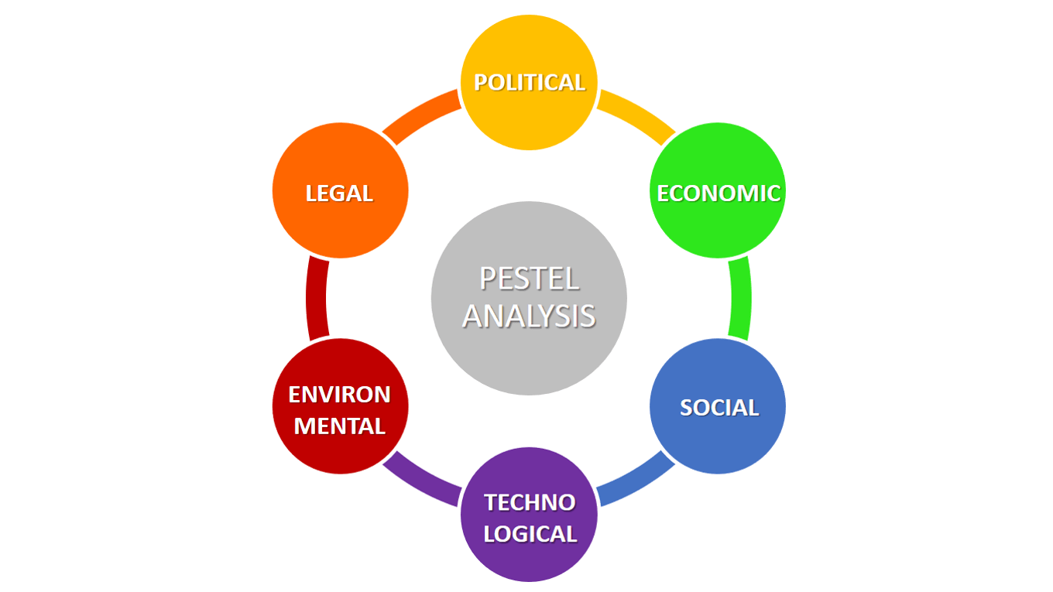
Macroenvironment: PESTEL
Includes all factors of the external environment that a firm cannot control, but that may affect supply and demand in a market.
  Political
  Economic
  Social
  Technological
  Ecological
  Legal

Slide 31
Integrated Model of Consumer Behavior
Internal influences Central psychological processes Psychographic variables
Recognition of a need
Information search
Evaluation of alternatives
Purchase decision
Post-purchase evaluation
External influences Reference groups Subcultures Cultures
Contextual influences
Environment Time Mood
Influences of the marketing mix
Product Price Distribution
Marketing communication

Slide 32
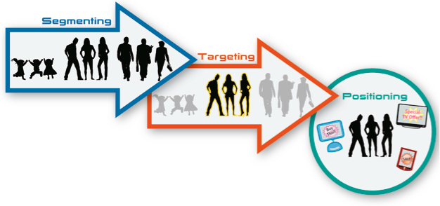
Marketing strategy: the “STP”

Slide 33
Segmentation variables
Segmentation variables
Sociodemographic variables
Geographic variables
Psychographic variables
Behavioral variables
Volume and profitability
Variables specific to a market
Combination of variables

Slide 34
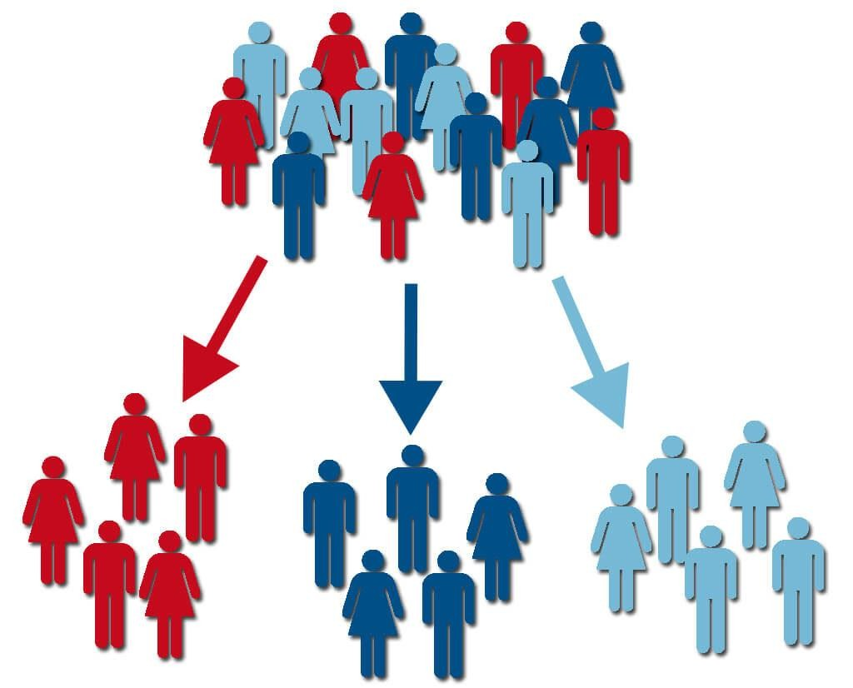
How & Why to Segment?
Divide the market into submarkets
Homogeneous customers (in some attributes) within same group
Groups should be different from each other
Make sure factors that are shared within a group of consumers affect their consumption behaviors!

Slide 35
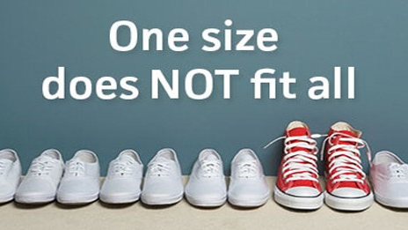
Targeting
Targeting a market segment means selecting exactly where the business wants to compete. It normally selects an area in which a firm has the best chance of succeeding.
Why target?
  Targeting is about a decision: concerning which segments to choose and how much to adapt marketing mix components to these segments
  Marketing Mix: Products, Price, Distribution and Marketing Communication

Slide 36
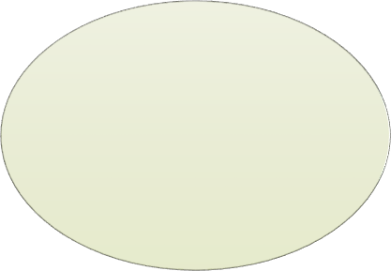

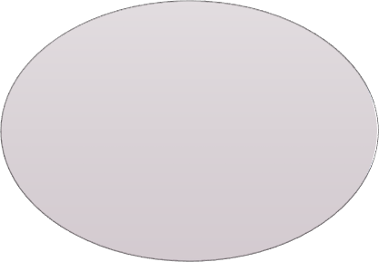
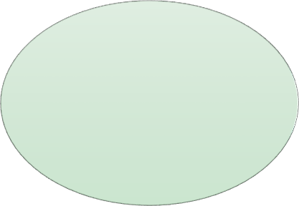
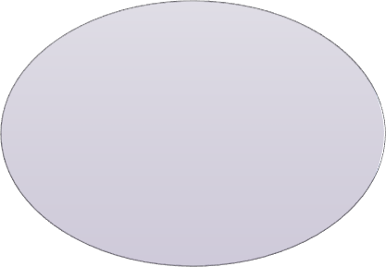
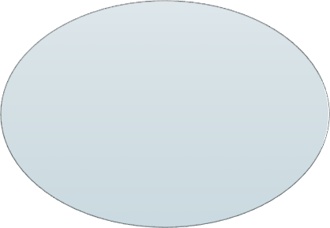
TARGETING
Factors to consider when selecting segments for targeting
Size
What are the costs to adapt one or more marketing mix for the target segment?
Adaption cost
Growth
Profitability
May be better to stay in a small market with few competitors than a big market with many competitors
Is there an economical way of reaching the target segment via distribution & promotion?
Competitive situation
Accessibility

Slide 37

Types of Targeting
Mass Marketing
Segment Marketing
  Concentrated segmentation
  Comprehensive segmentation
  Broad segmentation
Niche Marketing
Personalized Marketing

Slide 38

Positioning
Refers to the place that the brand or business occupies, or wishes to occupy emotionally and cognitively, namely, in the hearts and minds of customers in relation to competing brands or businesses
  Concerns identity, image & personality of a brand/business

Slide 39
The ‘Process’ of Positioning
Customer
Brand awareness and knowledge
Perceptions towards brand’s ATTRIBUTES
Feeling for the brand
Actual positioning
Desired positioning
Company/brand

Slide 40

Differentiation : To stand out!
Consists of a brand or company standing out from the others by getting the target customers to perceive it as different from the competition, in a positive sense, based on one or more significant attributes
Closely tied to positioning
Why differentiate?
  Without differentiation, a brand can compete with others solely based on price, which isn’t ideal!

Slide 41

How to differentiate?
Based on attributes that are important to the consumers
Differentiation must:
  Capture a competitive advantage that competitors don’t offer and cannot imitate
  Be visible
  Significant
  Authentic
Communicating a large number of differentiating points can be confusing
  Promotions with a single point of difference, or maximum two or three

Slide 42
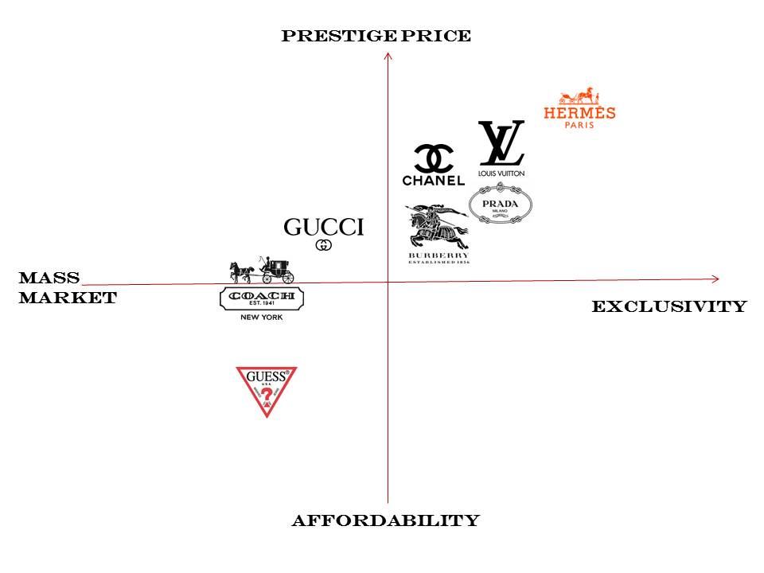

Slide 43
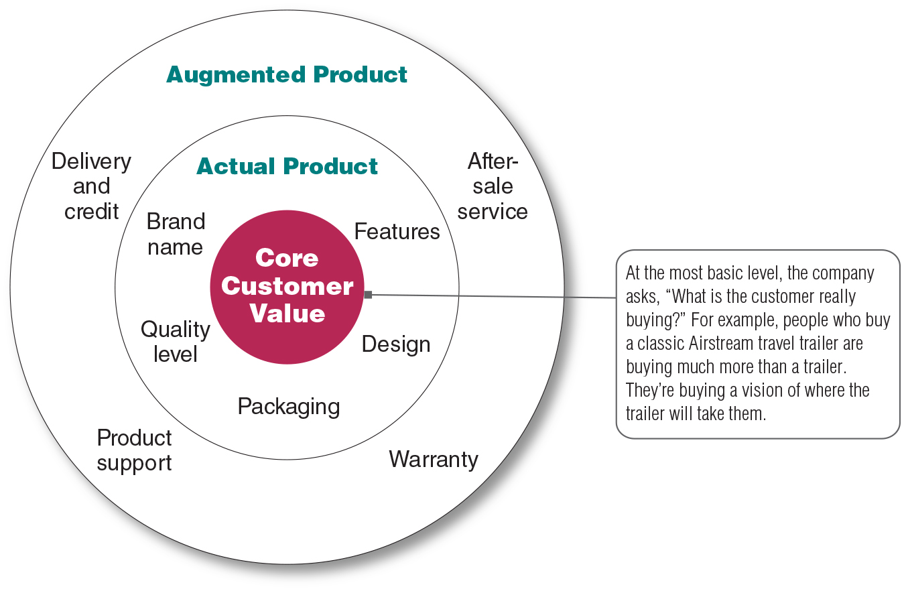
Product Dimensions
Source: Pearson 2023

Slide 44
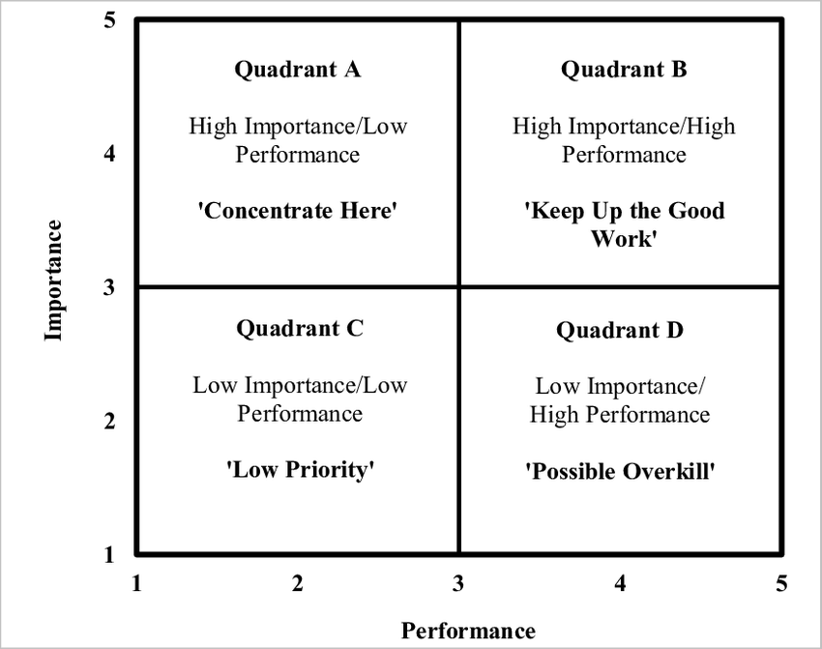
Importance-performance Analysis Of Product Quality

Slide 45

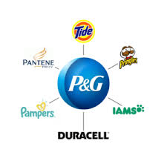
Strategic Brand Decisions
Umbrella brand: a brand whose name and signs appear on all products marketed by a particular company
  Pros: the brand is visible, unified and clear
  Cons: difficult to develop sub-brands; Made all products vulnerable in the case of branding failure
House of brands: each brand in the portfolio is treated independently

Slide 46
Brand Management: Brand Extension & Launches
 | Existing product category | New product category
Existing brand name | Line extension | Brand extension
New brand name | Multibrand approach | New brand creation

Slide 47
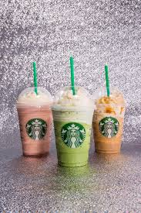

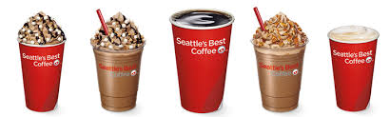
Line extensions
Multibrand approach

Slide 48
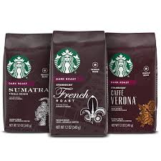
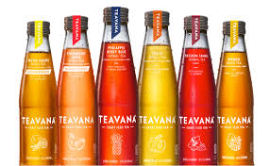
Brand extensions
New brand creation

Slide 49
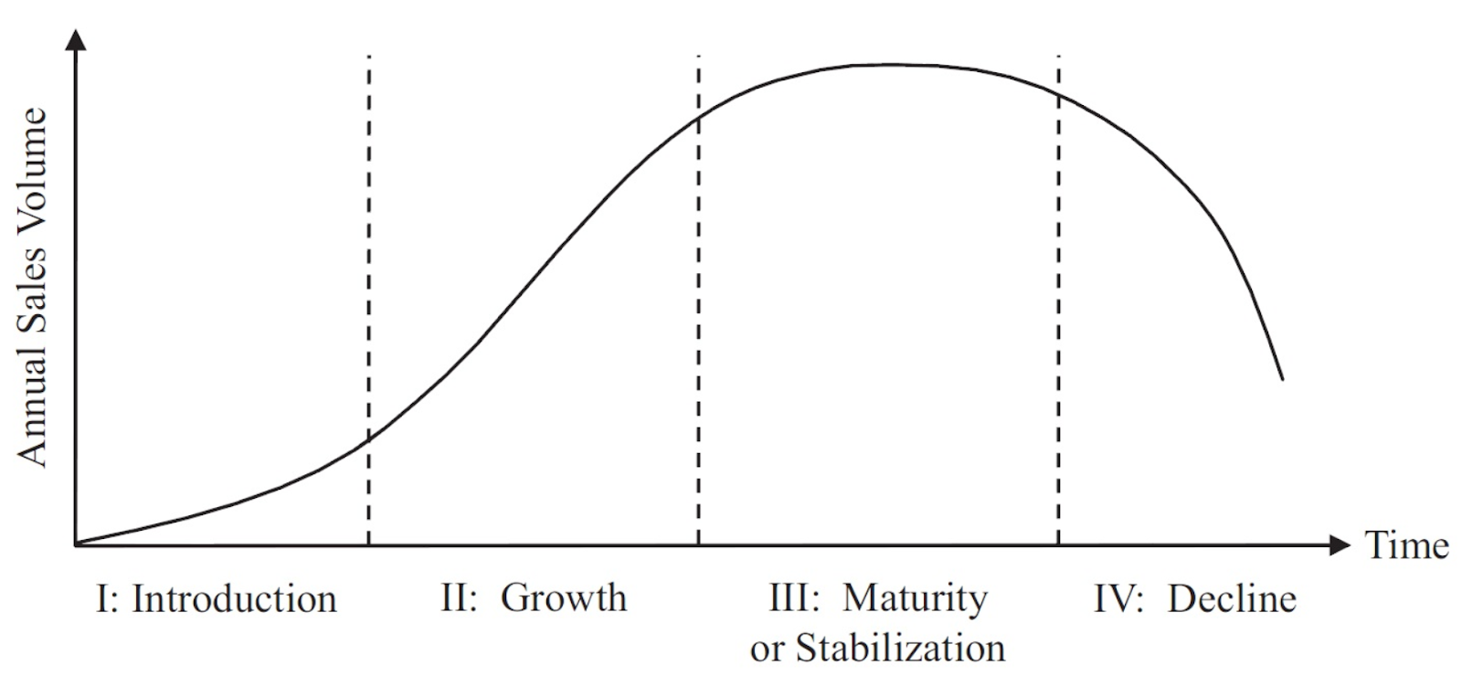
Product Life Cycle
Profit decline
Declining Competition
Profit growth
Growing Competition
Profit decline
Declining Competition
Losses
Limited Competition
Product management conditions change over time
  Introduction
  Growth
  Maturity
  Decline

Slide 50
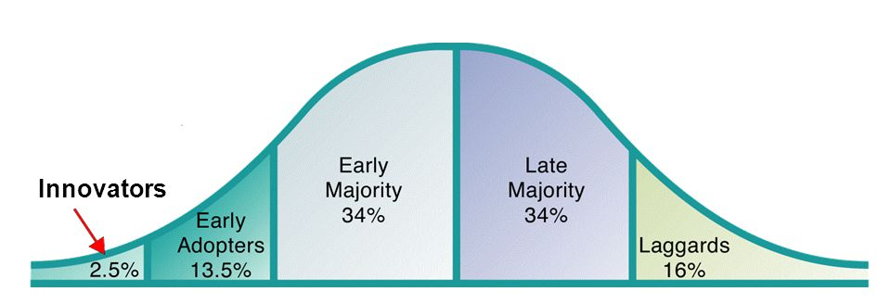
Diffusion of Innovation

Slide 51
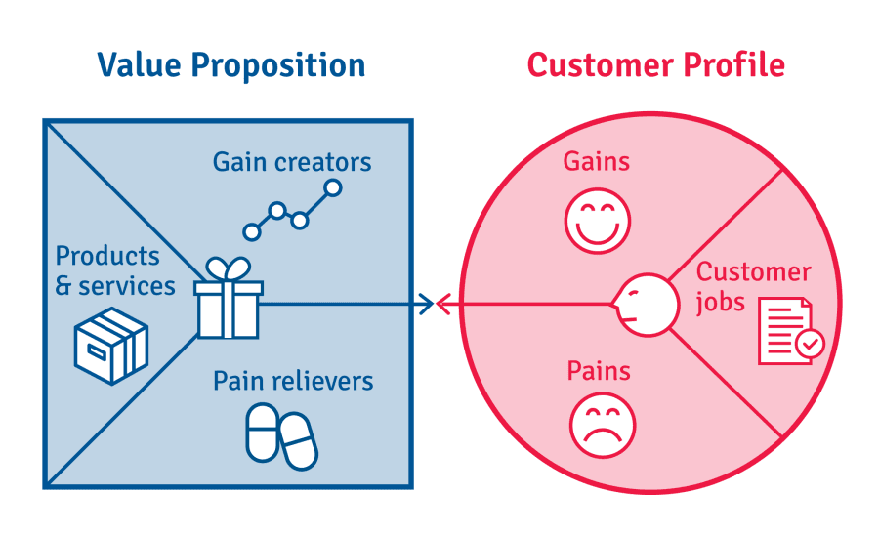
Value Proposition Matrix
Understand customers’ behaviors, needs and difficulties
Propose solutions

Slide 52
Environmental Influences
Internal Environment
External Environment
Competition
Consumers
Distribution intermediaries
Economic environment
Governments
Legal environment
Company’s costs
Existing product line
Product life cycle
Price-setting process

Slide 53
Pricing Strategies
Pricing strategies and contexts
External influences
Competitive pressure
Consumer preferences
Internal influences
Company cost
Price leadership
Competitive parity
Low-cost pricing
Price signaling
Product lines
Product life cycle
Launch: skimming or penetration
Growth: lower prices because of competition
Maturity: discounts and reductions
Decline: sharp drop in prices or withdraw
Cost-plus pricing
Complementary product pricing
Price bunding
Customer value

Slide 54
Customer Value-Based Pricing
Value-based pricing uses the buyers’ perceptions of value rather than the seller’s cost.
Value-based pricing is customer driven.
Cost-based pricing is product driven.
Price is set to match perceived value.

Slide 55
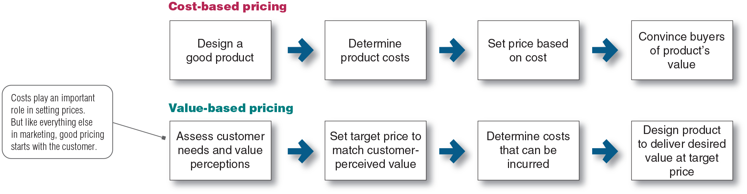
Cost-based Pricing vs. Value-based Pricing

Slide 56
Pricing strategies based on PLC
Launch
Penetration Pricing OR
Market Skimming
Growth
Lower prices as competition increases
Maturity
Rebates & reductions
Decline
Sharp drop of prices (liquidation)
Profit decline
Declining Competition
Profit growth
Growing Competition
Profit decline
Declining Competition
Losses
Limited Competition

Slide 57
Distribution Intermediaries
The main purpose of a distribution network is to make a manufacturer’s product available to potential consumers in the form and quantity, and the time and place desired, so as to create continuous business relationships between network members
To make this work efficient and smooth, “intermediaries” (i.e., ‘middle men’) are used
These “intermediate channels” help transfer ownership of a product from producer to the consumer or the business user
Producer
Distribution channel
Customer

Slide 58
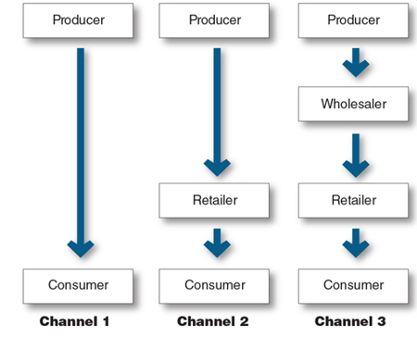
Number of Channel Levels
Channel length/: The number of intermediary levels
Direct marketing channel: no intermediary levels
Indirect marketing channel contains one or more intermediary levels

Slide 59

Distribution Intensity
The number of intermediaries used at each level of channel

Slide 60
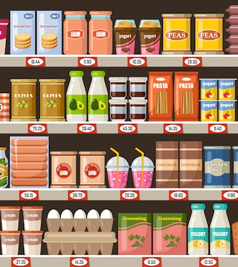
Intensive distribution
A strategy in which products are stocked in as many outlets as possible
Extensive coverage of all appropriate points of sale
Linked to mass marketing which aims to make a product as easily available as possible for the largest target possible
Requires the greatest involvement from a manufacturer
Commonly used for sale of everyday items

Slide 61
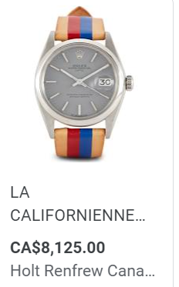
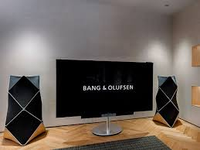
Exclusive distribution
The producer gives only a limited number of dealers the exclusive right to distribute its products in their territories
Niche or high-end positioning generally
Optimal product presentation

Slide 62
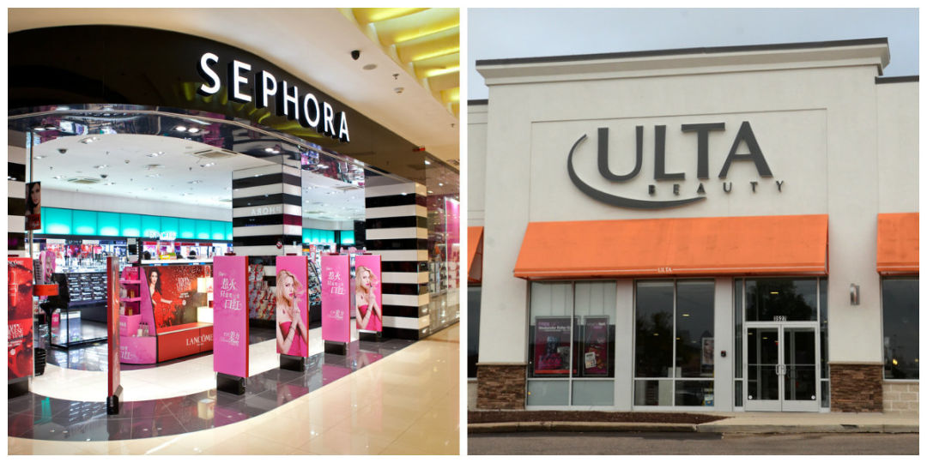
Selective Distribution
The use of more than one but fewer than all of the intermediaries who are willing to carry a company’s products
Commonly used for consumer electronics, furniture, and appliance brands

Slide 63

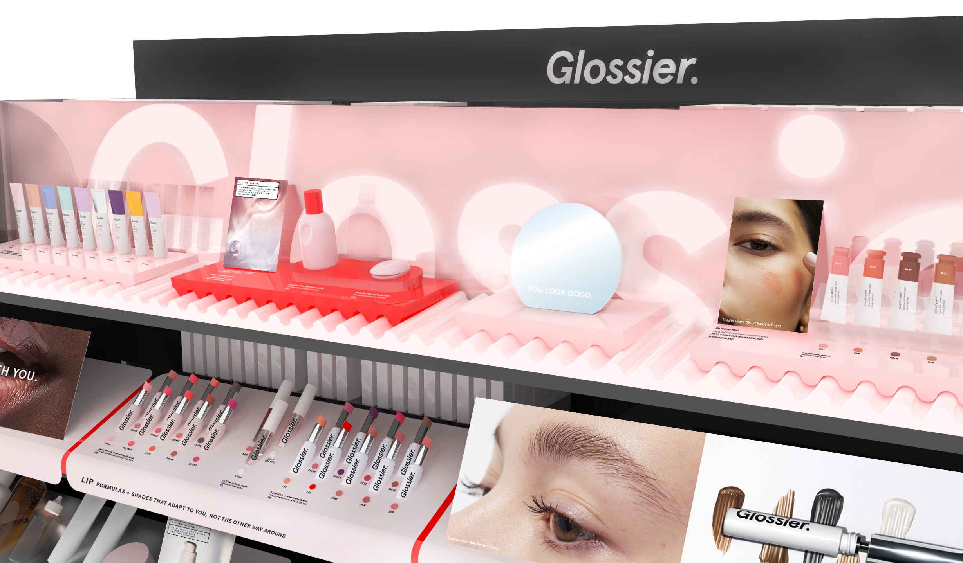

Disintermediation
Cutting out of marketing channel intermediaries by producers or the displacement of traditional resellers by new intermediaries
D2C business models became super common with online retail

Slide 64
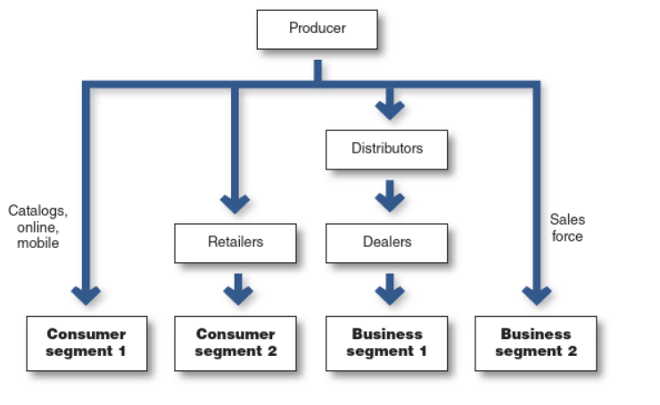
Multichannel distribution systems
Systems in which a single firm sets up two or more marketing channels to reach one or more customer segments

Slide 65
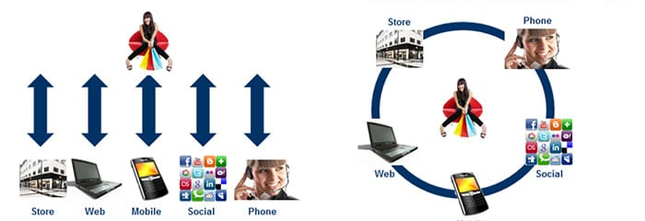
Multichannel vs. Omnichannel

Slide 66
Marketing Objectives & Marketing Mix
Marketing objectives
The marketing mix
Product
Price
Communication
Place (distribution )
Integrated marketing communications
Advertising
Public relations
Personal selling
Direct marketing
……
Sales promotion

Slide 67
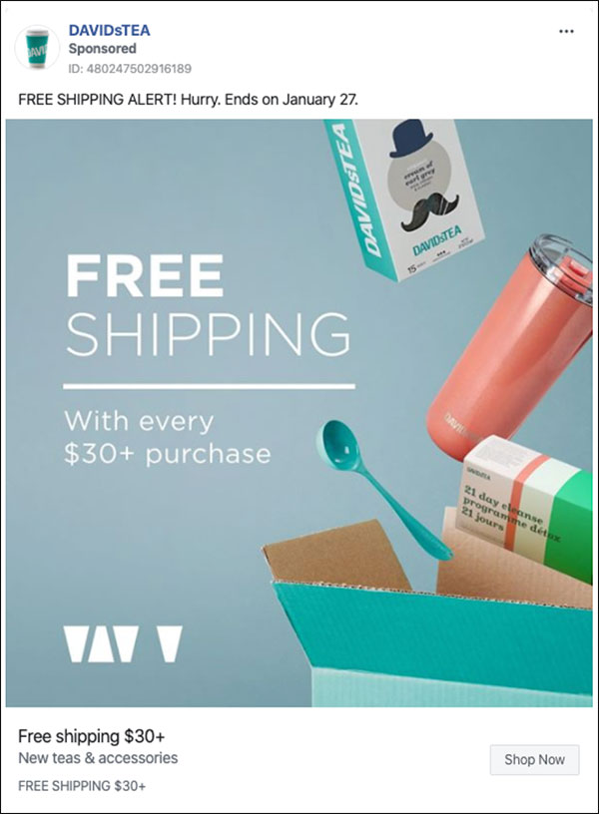

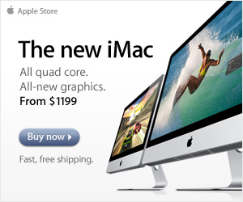
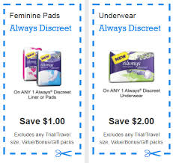
Planning Communication Mix
Setting communication objectives
  Communication Objectives: what the target should know, think, feel or do after exposure to a communication
  Examples:
    Build awareness of a brand
    Inform consumers that an offer exists
    Change consumers’ attitude toward a brand or offer
    Steer traffic toward a website
    Stimulate trials, buy or rebuy
Setting Key performance indicators (KPI)
Defining Key message
Selecting the communication media
Timetables/allocating budget & resources
Contingency plan

Slide 68


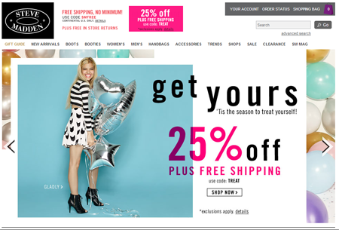
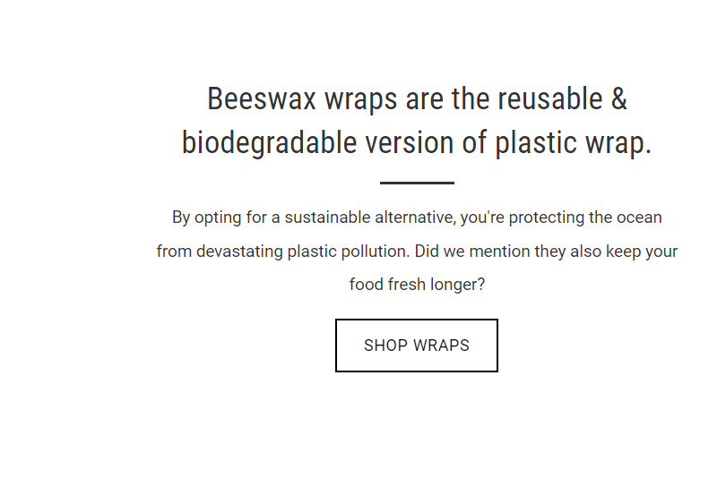
Message Content
Rational Appeal: Relates to the audience’s self-interest, conveys product/service benefits
Emotional Appeal: Attempt to stir up positive or negative emotions to motivate a purchase
Moral Appeal: Directed to an audience’s sense of what is right and proper
Conative messages: Designed to lead to some type of consumer response

Slide 69

Marketing Communication Media
Advertising
Contact and experiential marketing
Public
relations
Ecosystem
360° communication
Social
media
Target segment
Direct and relationship marketing
Digital and mobile marketing
Sponsorship
Sales
promotion

Slide 70
Types of communication media
Traditional media (TV, radio, print…)
Online & Mobile advertising
Sponsorship
Product placement
Events
Company’s stores
Webpages
Official accounts on social media
Paid media
Owned media
Earned media
WOM
Customer’s social media
News articles
Social media influencers

Slide 71
KPI’s in Advertising
Reach
Percentage of the target group exposed, at least once, to a set of media during a certain period of time
Opportunity to see/Frequency
Number of times that the target population is exposed to a message
Cost per thousand (CPM)
Cost per 1000 (e.g. $11 paid for 1000 views)
Share of Voice
A brand’s portion of media purchases relative to its competitors

Slide 72
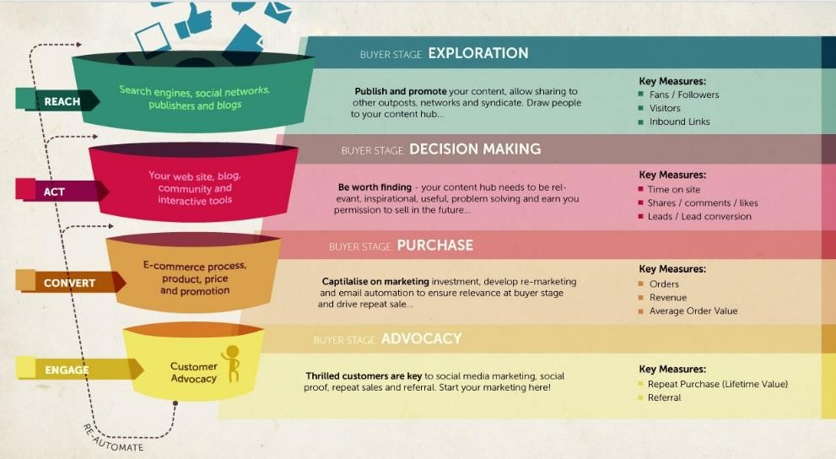
Digital Marketing

Slide 73
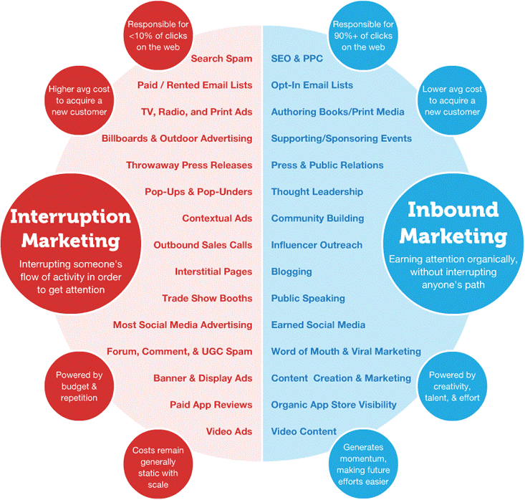
Inbound Marketing | Outbound Marketing
Two-way | One-way
Rising | Dying
Cheaper | Expensive
Unobtrusive | Obtrusive
Source: Performance Media

Slide 74


Search
SEA
Engine Results Page (SERP)
SEA
SEO

Slide 75



Content Marketing
Objective: Reinforce brand affinities through relevant, informative, educational, useful or playful content

Slide 76
Practice Exercise
You are the marketing team for FreshFizz, a new sparkling fruit drink launching in Singapore. FreshFizz contains natural fruit flavours, has no added sugar, and is positioned as a refreshing alternative to traditional soft drinks.
Your company has developed the product but has not yet decided how to price or distribute it.
You have the following information:
Production cost: S$1.20 per can.
Competing soft drinks generally sell for S$1.50–S$2.50.
Premium sparkling drinks typically sell for S$3.00–S$4.50.
Your target consumers are young professionals aged 25–40 who are health-conscious but also value convenience.
All prices and market information are hypothetical for this exercise.

Slide 77
Pricing
Would you recommend penetration pricing or market-skimming pricing for FreshFizz's launch? Explain your reasoning.
What retail price would you set for FreshFizz? Would you adopt cost-based pricing or customer value-based pricing? Justify your decision.
Imagine demand increases significantly during Singapore's hottest months. Would you recommend dynamic pricing? Why or why not?

Slide 78
Distribution
Would you use any distribution intermediary? Explain your choice briefly
Which distribution strategy would you recommend: intensive, selective, or exclusive distribution? Explain why.

Slide 79
What Next?
Six months after launch, FreshFizz has gained popularity. However, a competitor introduces a similar drink at S$1.80, while retailers demand higher margins to continue stocking FreshFizz.
Would you change your pricing strategy, distribution strategy, both, or neither? Defend your decision.

Slide 80
Thank You!

